Slide 1


Microbiome data analysis in R/Bioconductor
Levi Waldron
June 5, 2018
Notes:
Hi. I’d like to introduce you to MultiAssayExperiment, a framework for the representation and analysis of multi-omics experiments in Bioconductor.

Slide 2
Outline
Methods:
Exploratory data analysis
Distances and Principal Coordinates Analysis
Linear modeling for differential abundance (log-linear models, zero inflation)
Tools:
curatedMetagenomicData
phyloseq
metagenomeSeq

Slide 3


Population-representative sample of non-institutionalized adults in NYC
Conducted by CUNY SPH and the NYC DOHMH
Lorna Thorpe & Sharon Perlman, PIs
Microbiome analysis by my group and Nicola Segata’s lab
Notes:
First of all I want to introduce NYCHANES which is a project started in 2013 and coordinated by two NY institutions, the CUNY School of public Health and the Department of Health and Mental Hygene. Pratically speaking It’s a large-scale survey made to assess the health status of adult new yorkers.

Slide 4
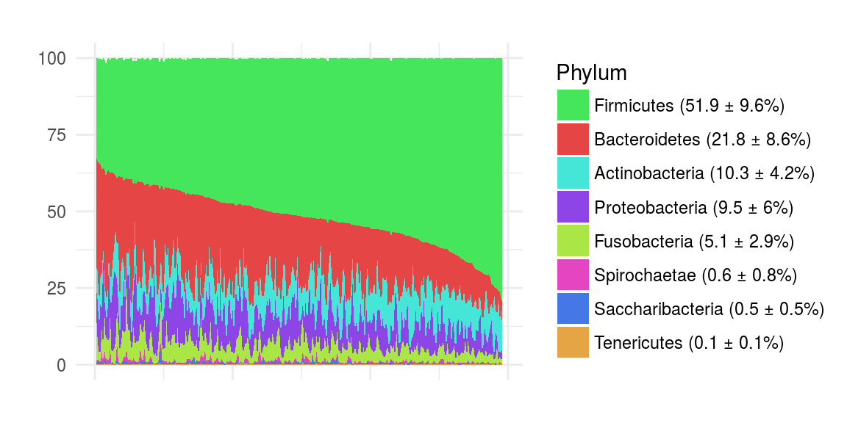
Exploratory data analysis
Phylum-level abundances across all NYC-HANES oral microbiome samples

Slide 5
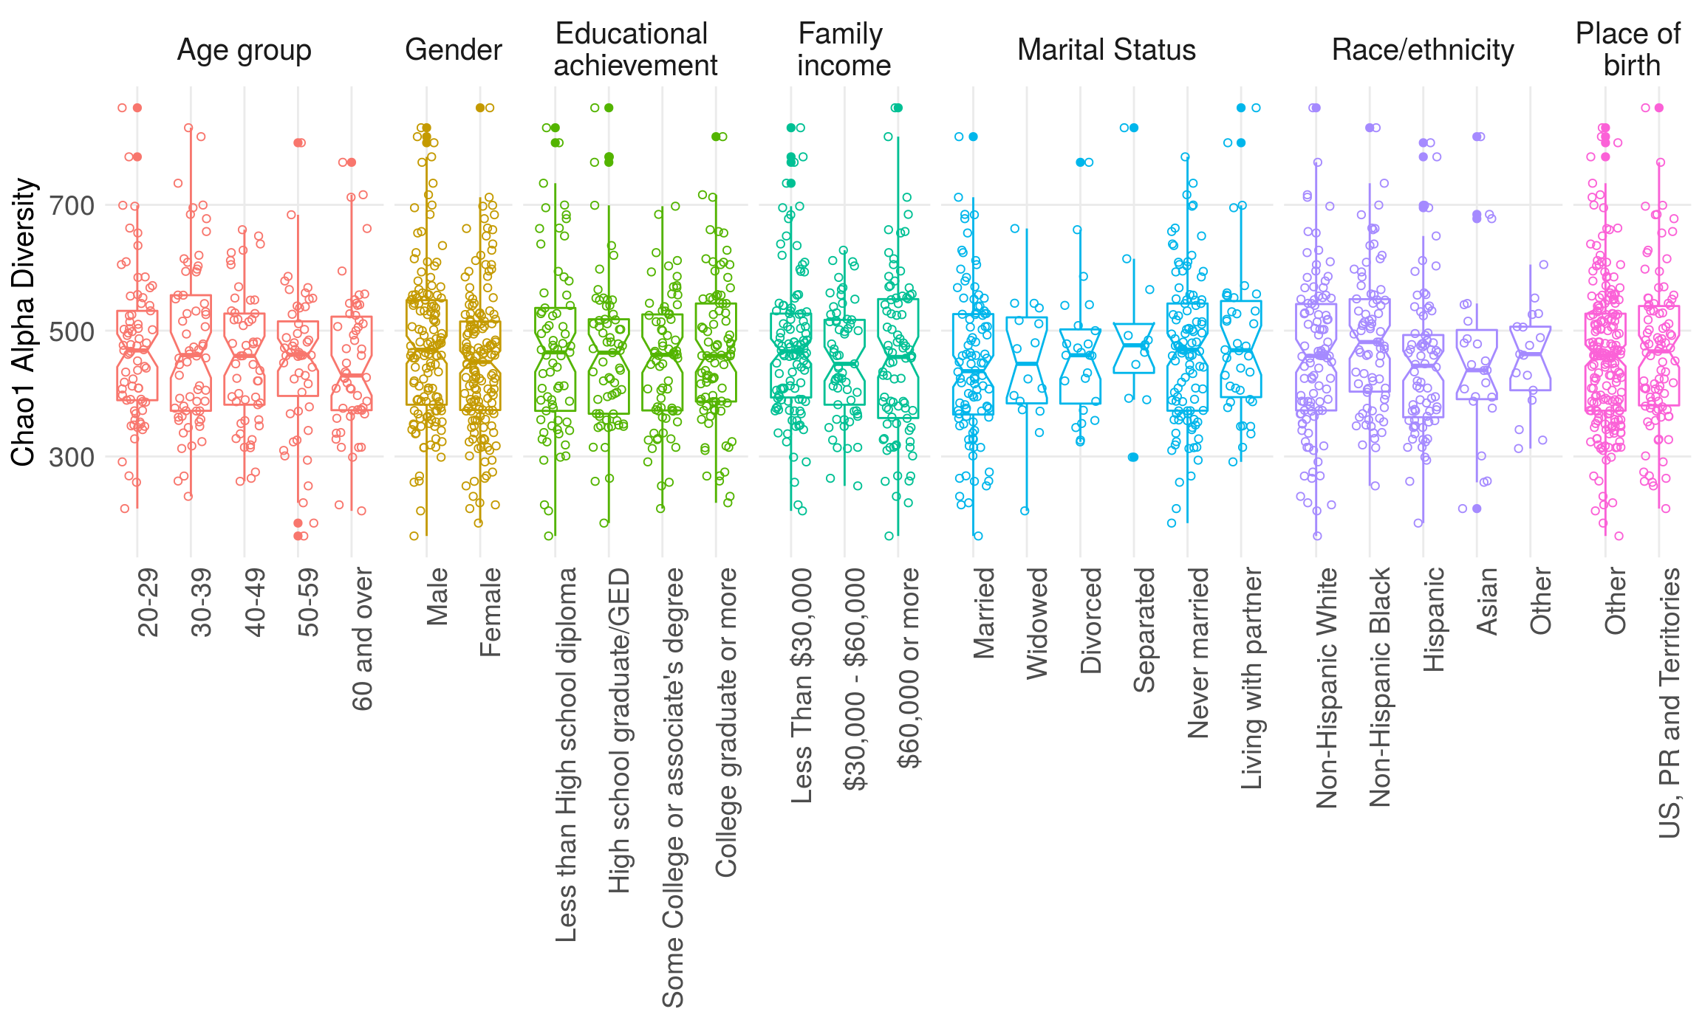
Alpha diversities

Slide 6
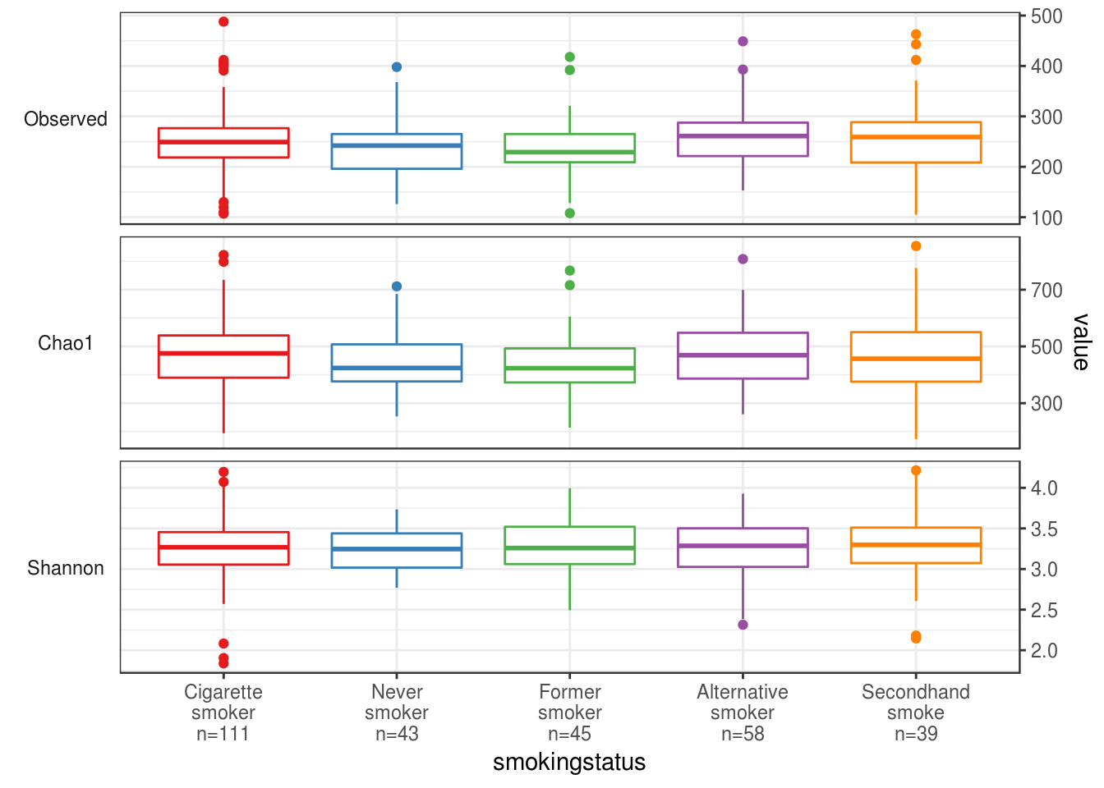
Alpha diversities

Slide 7
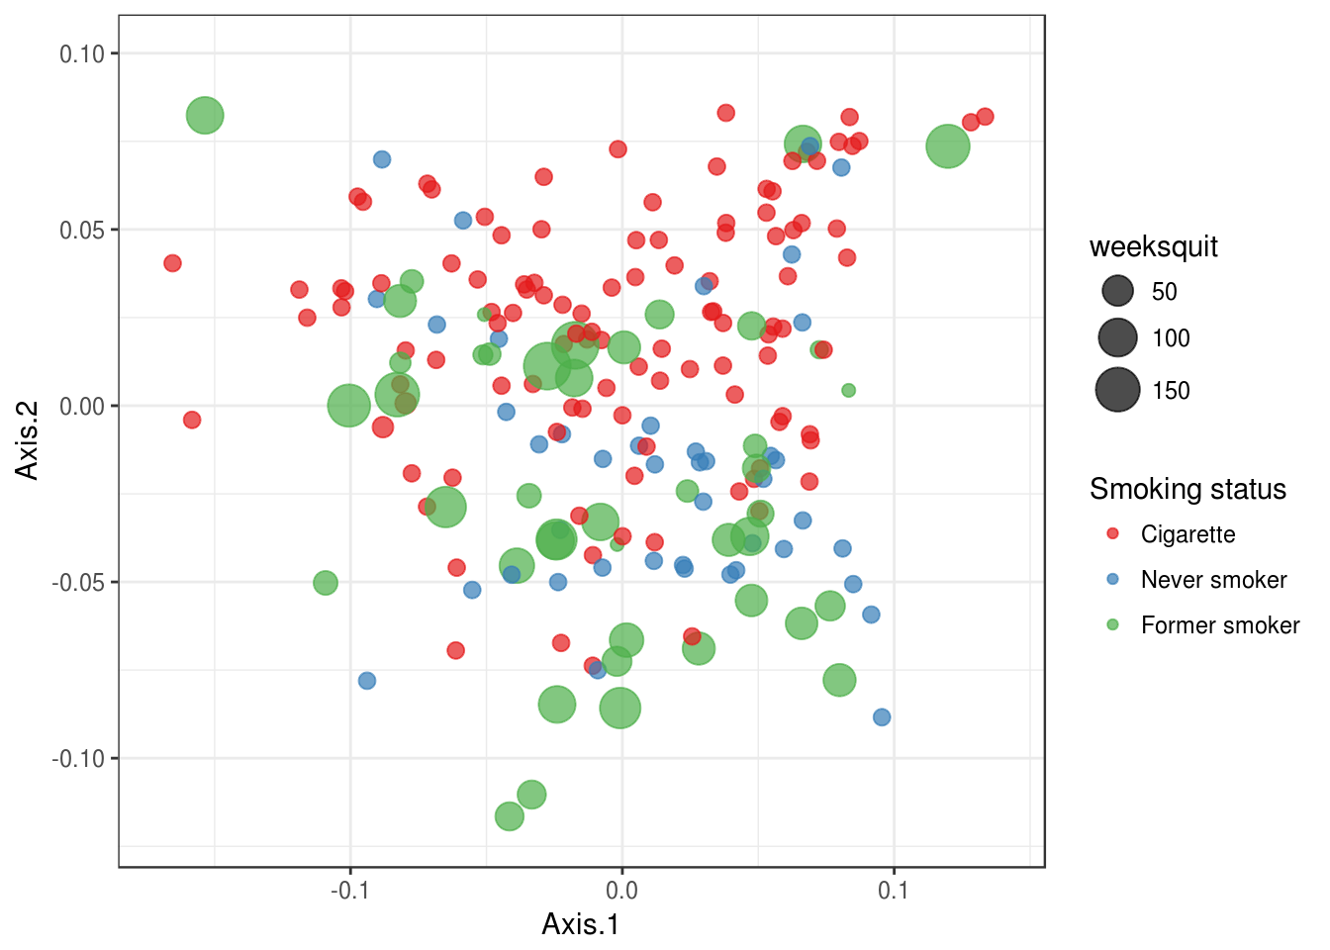
Distances and PCoA

Slide 8
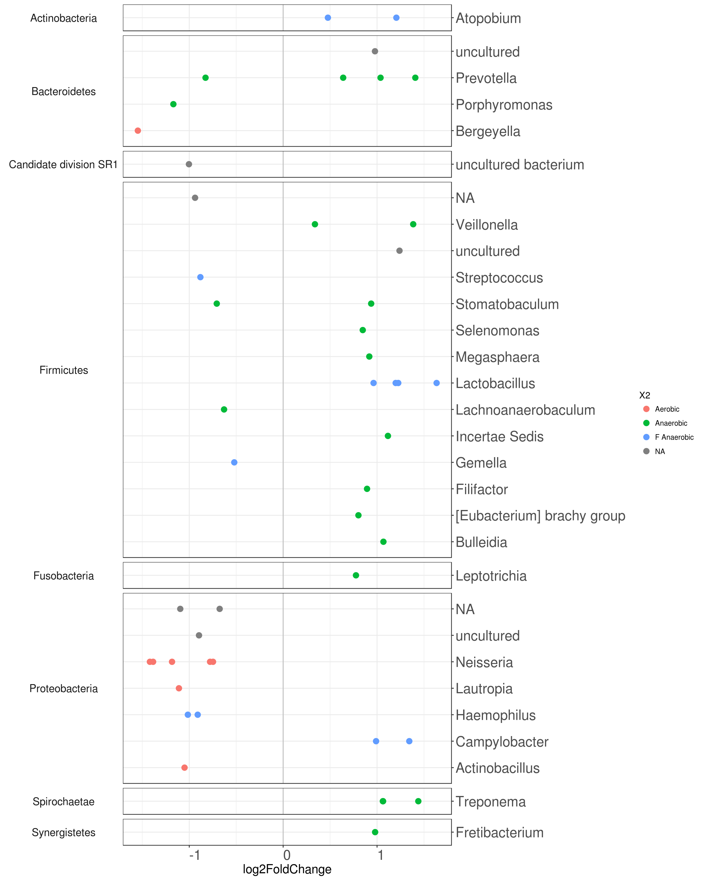
Differential Abundance

Slide 9
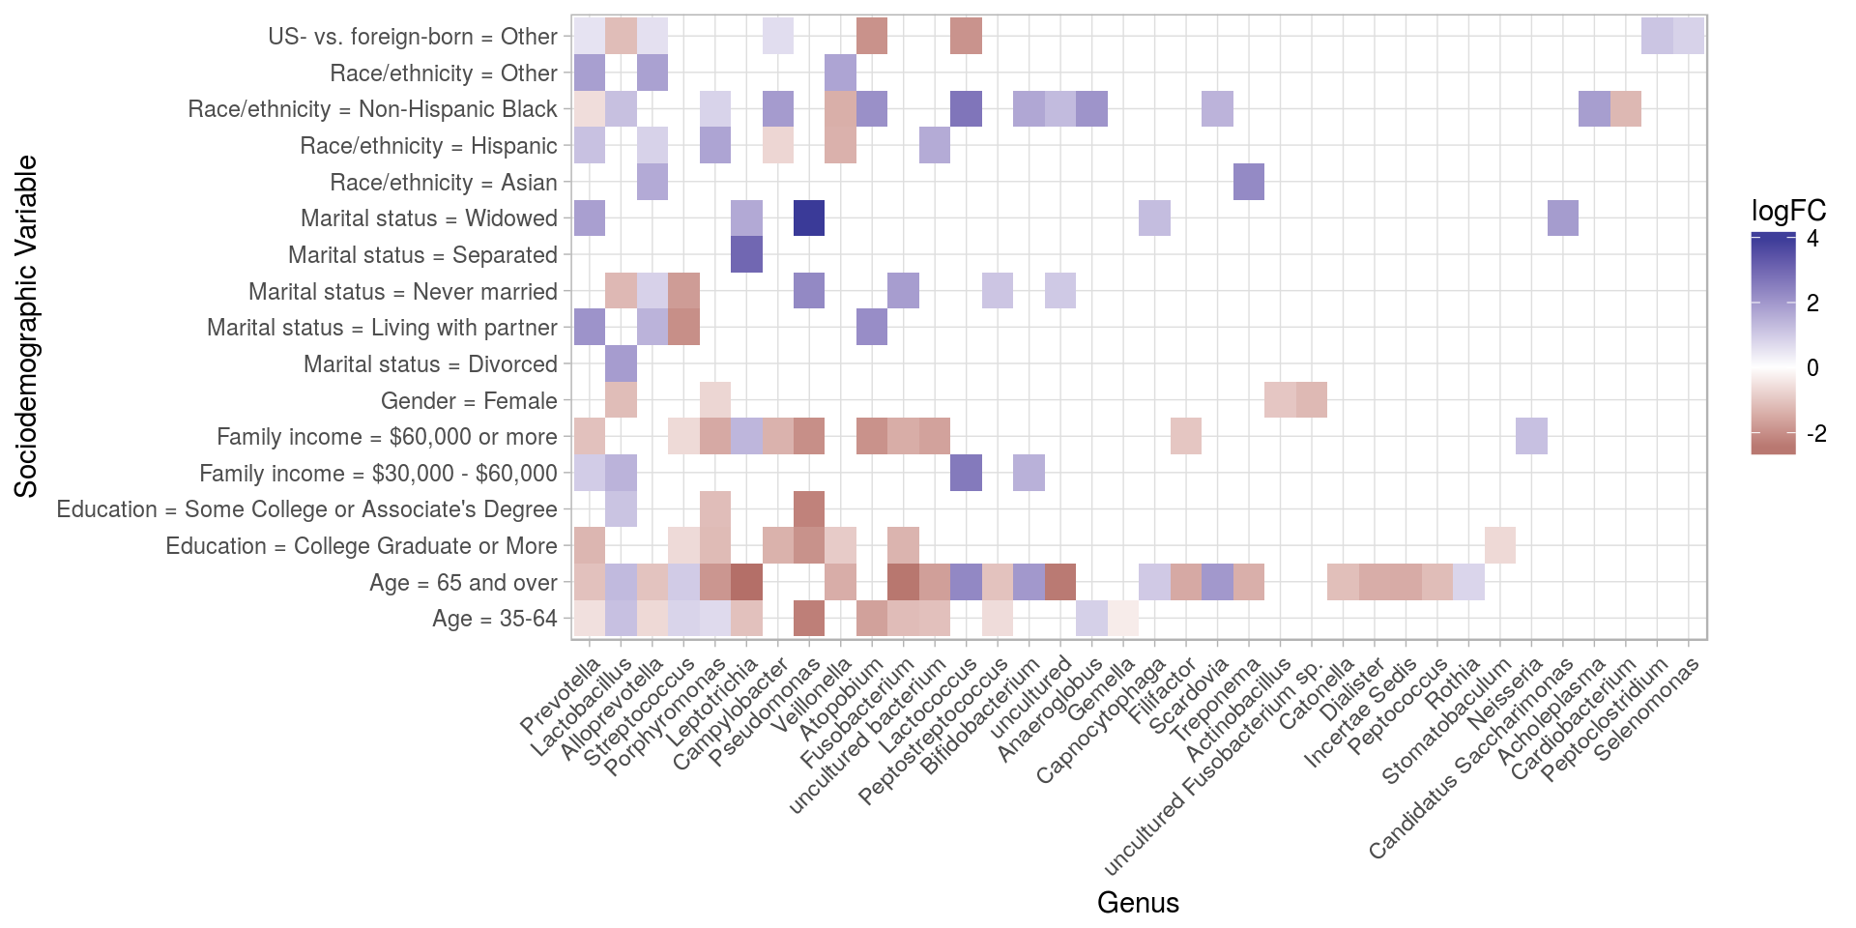
Screening for Differential Abundance

Slide 10
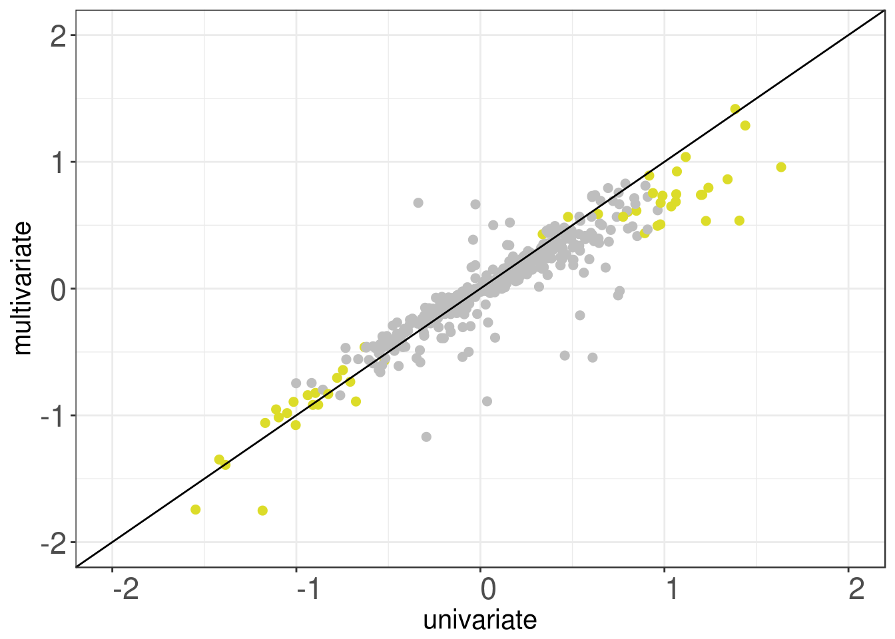
Correcting for confounding

Slide 11
curatedMetagenomicData
Bioconductor & command-line tool providing:
25 datasets (5,716 samples)
34 diseases, 28 countries
manually curated metadata
Six data products per dataset
Three taxonomy-based from MetaPhlAn2
Three functional from HUMAnN2
https://waldronlab.github.io/curatedMetagenomicData/analyses/
Pasolli/Schiffer/Manghi et al., bioRxiv 103085

Slide 12


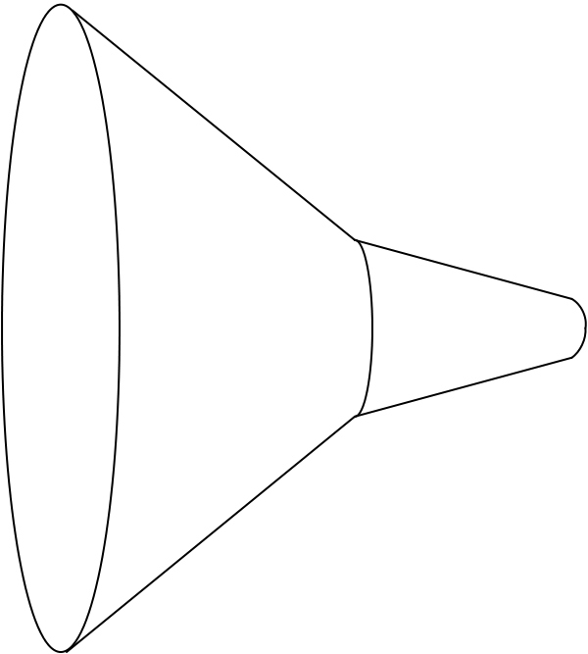
curatedMetagenomicData pipeline
Raw
fastq files
13 datasets
2,875 samples
Study metadata
Age, body site, disease, etc…
Differential abundance
Diversity metrics
Clustering
Machine learning
Convenience download functions
Megabytes-sized datasets
Download (~57TB)
ExperimentHub product
Amazon S3 cloud distribution
Tag-based searching
Dataset snapshot dates
Automatic local caching
Uniform processing
Manual curation
MetaPhlAn2
HUMAnN2
Automatic documentation
species abundance
metabolic pathway abundance
Integrated Bioconductor ExpressionSet objects
Per-patient microbiome data
Per-patient metadata
Experiment-wide metadata
marker
presence
metabolic pathway presence
standardized metadata
marker abundance
gene family abundance
Integration
Offline high computational load pipeline
> 120 kH CPU
https://waldronlab.github.io/curatedMetagenomicData/
Notes:
https://upload.wikimedia.org/wikipedia/commons/thumb/7/7e/Funnel_Mech.svg/667px-Funnel_Mech.svg.png
https://pixabay.com/en/cheering-happy-jumping-people-297419/

Slide 13
curatedMetagenomicData use
One dataset from R:
> curatedMetagenomicData("HMP_2012.metaphlan_bugs_list.stool”)
, relab=FALSE)
Many datasets from R:
> curatedMetagenomicData("HMP_2012.metaphlan_bugs_list.*”)
Command-line:
$ curatedMetagenomicData -p "HMP_2012.metaphlan_bugs_list.*"
Pasolli/Schiffer/Manghi et al., bioRxiv 103085

Slide 14
Supervised disease classification
Credit: Edoardo Pasolli
Pasolli/Schiffer/Manghi et al., bioRxiv 103085

Slide 15
Unsupervised clustering
Credit: Audrey Renson
Pasolli/Schiffer/Manghi et al., bioRxiv 103085

Slide 16
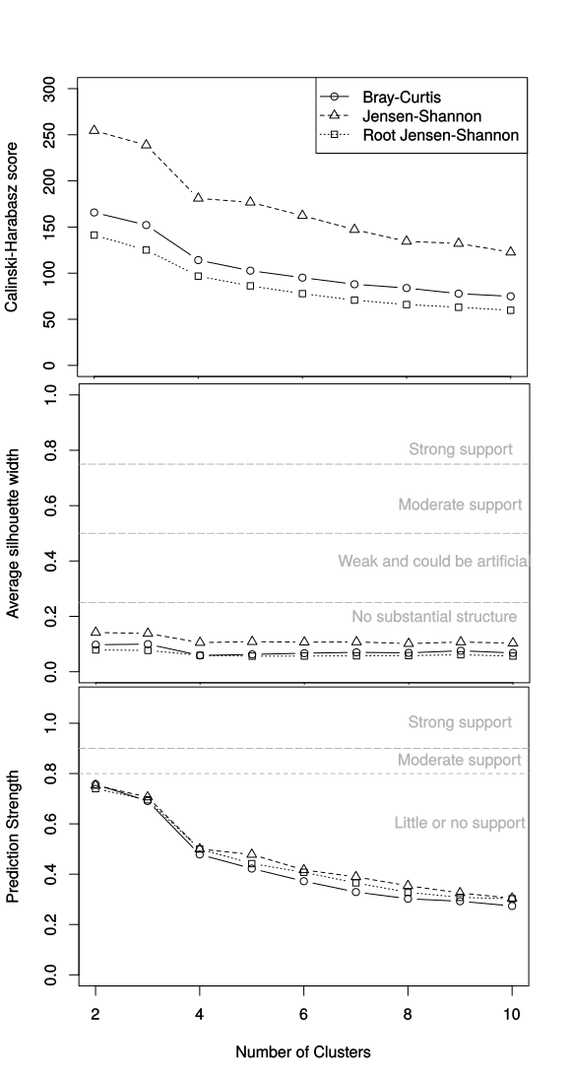
Unsupervised clustering
Credit: Audrey Renson
Pasolli/Schiffer/Manghi et al., bioRxiv 103085

Slide 17
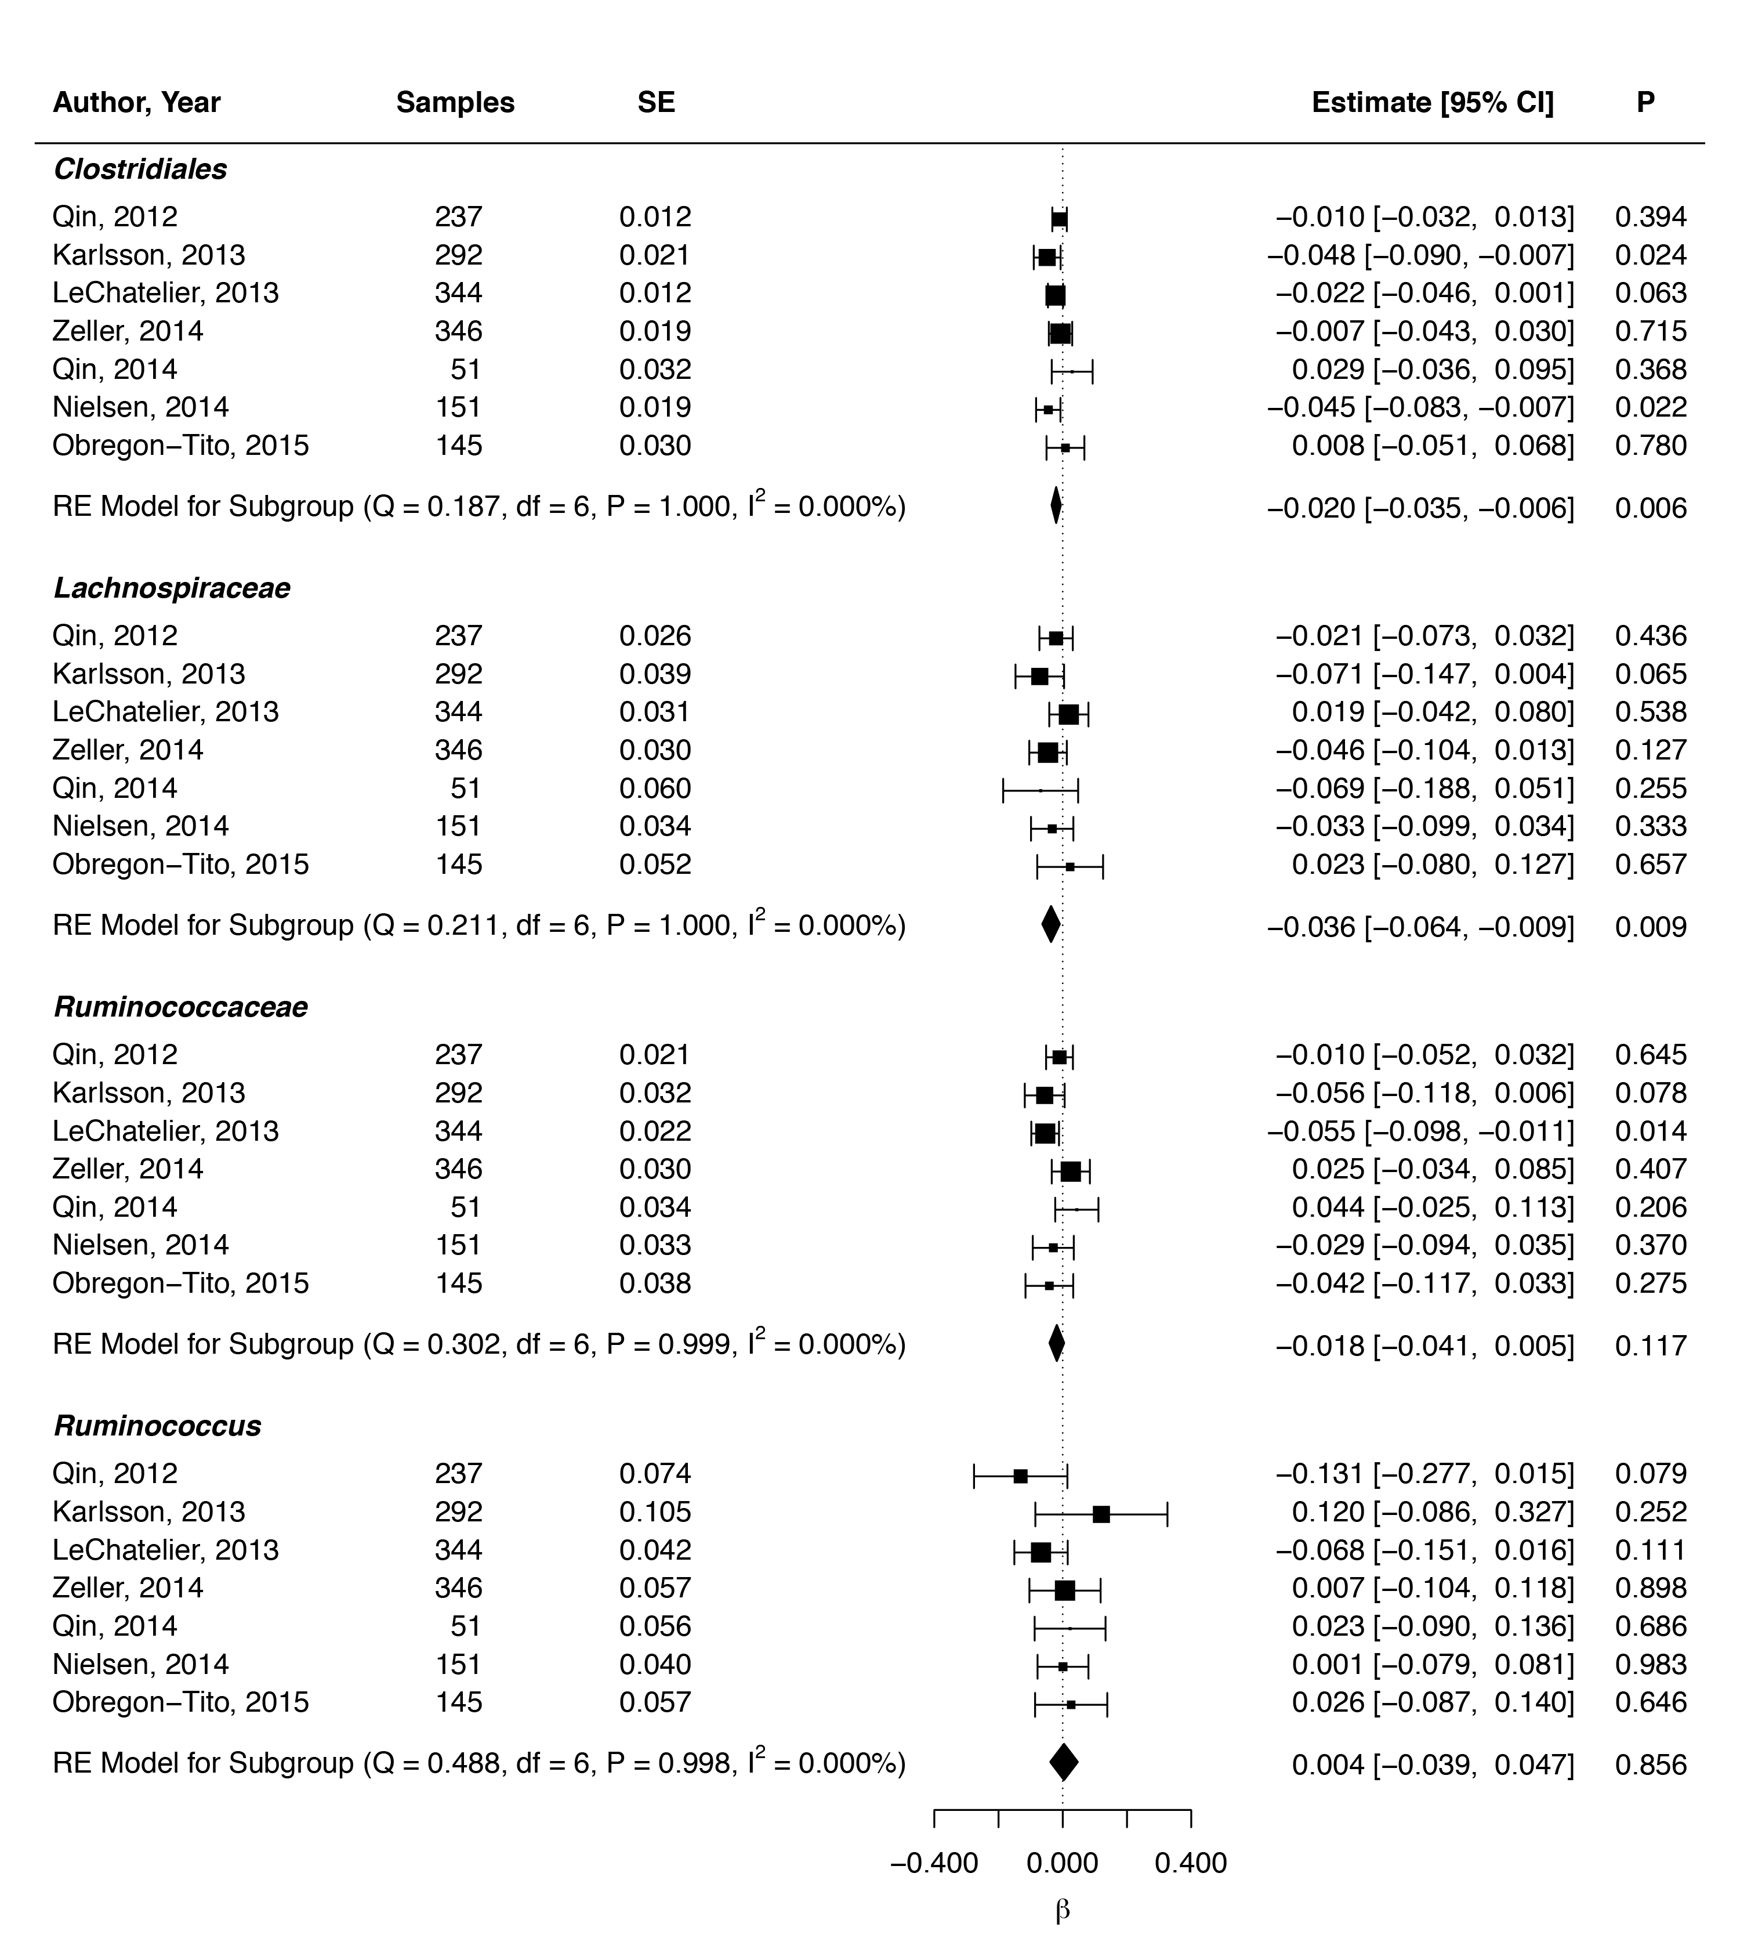



Meta-analysis
(partial) validation of reported associations between genera and BMI
Credit: Lucas Schiffer
Beaumont M et al. Heritable components of the human fecal microbiome are associated with visceral fat. Genome Biol. 2016;17:189.

Slide 18
Summary of R/Bioconductor tools
phyloseq
taxonomy-aware data management & plotting
alpha & beta diversity
Links to QIIME, packages for differential abundance
metagenomeSeq
Zero-inflated negative binomial models
Links to metavizr metagenome browser
curatedMetagenomicData
Links to phyloseq and metagenomeSeq
MultiAssayExperiment
Integrative data management for multi-omics experiments
DESeq2, edgeR, metafor, caret, …

Slide 19
Thank you
Lab (www.waldronlab.org / www.waldronlab.github.io)
Lucas Schiffer (curatedMetagenomicData), Marcel Ramos (MultiAssayExperiment)
Audrey Renson, Andy Samedy, Rimsha Azar, Carmen Rodriguez, Tiffany Chan, Abzal Bacchus, Jaya Amatya, Ludwig Geistlinger
Collaborators
Nicola Segata lab (curatedMetagenomicData)
Francesco Beghini, Edoardo Passoli, Paolo Manghi
Huttenhower lab
Heidi Jones, Jennifer Dowd, Sharon Perlman, Lorna Thorpe, Robert Burk Lab (NYC-HANES)
Valerie Obenchain, Martin Morgan (Bioconductor core team)
CUNY High-performance Computing Center
Bioconductor core team
Notes:
met Jin Xu from East China Normal University, Shanghai

